Slide 1
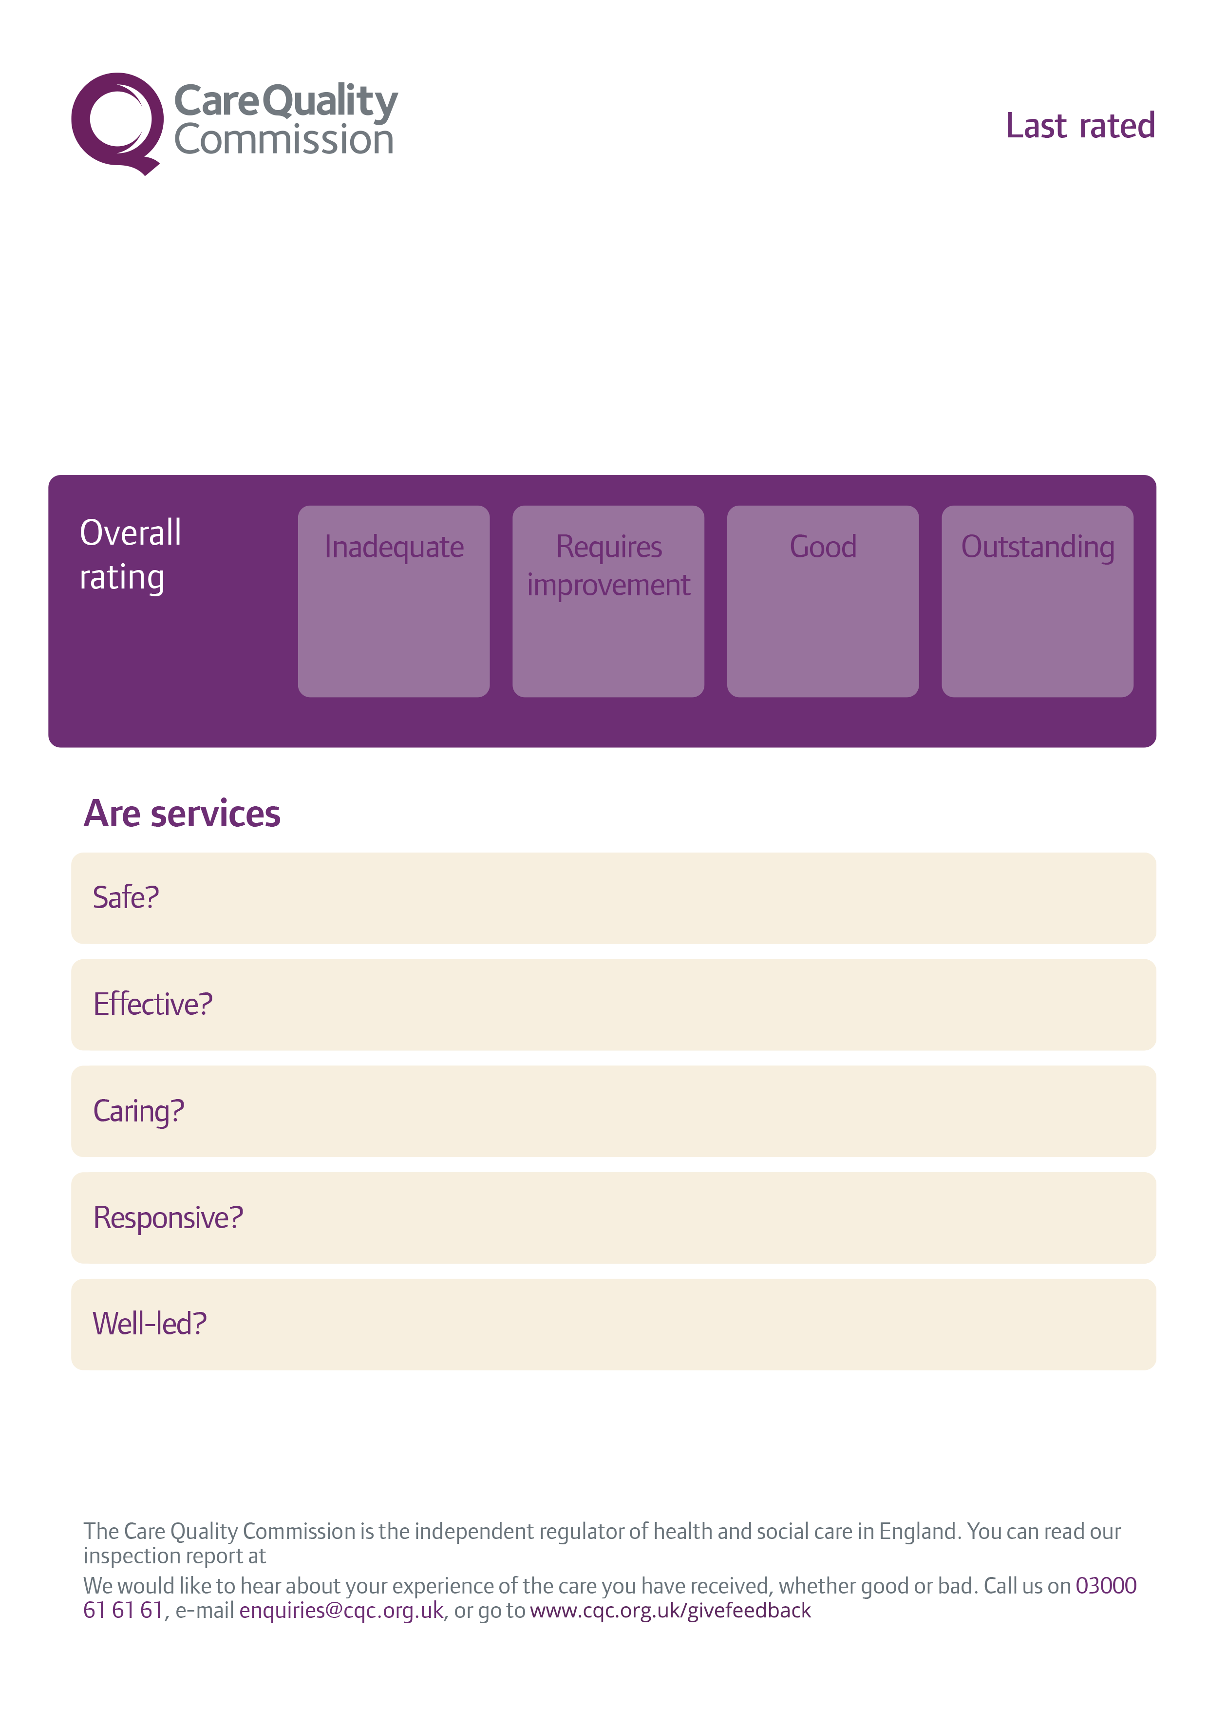








08/05/2025
Barnsley Road Surgery
899, Barnsley Road Sheffield S5 0QJ
www.cqc.org.uk/location/LOCATIONIDHERE

